Slide 1


Neha M Dharwad
26/06/2025

Slide 2

Outline
Executive Summary
Introduction
Methodology
Results
Conclusion
Appendix

Slide 3
Executive Summary
Summary of methodologies:
Data Collection: Via SpaceX API and web scraping (Python, BeautifulSoup)
Data Wrangling: Handled missing values, formatted fields, encoded categories
EDA: With Data Visualization and SQL
Building an Interactive map with Folium
Building a dashboard with Plotly
Predictive Analysis
Summary of all results
Success rates varied by launch site and booster version
Payload mass showed a moderate impact on success
Decision Tree and SVM models performed best, with ~85–90% accuracy
SQL revealed top-performing sites and boosters

Slide 4
Introduction
Project background and context:
SpaceX, a leader in commercial spaceflight, has conducted numerous rocket launches with varying degrees of success. Understanding the factors that contribute to a successful launch is critical for improving mission reliability and reducing costs. With rich historical launch data publicly available, this project leverages data science to gain insights and build predictive models for launch outcomes.
Problems you want to find answers
Which launch sites have the highest success rates?
How does payload mass affect mission success?
Do booster types influence launch outcomes?
Can we predict the success of a future launch based on available features?

Slide 5

Section 1

Slide 6
Methodology
Executive Summary
Data collection methodology:
Using SpaceX Rest API
Using Web scraping from Wikipedia
Perform data wrangling
Filter data, handle missing values and use One hot encoding to prepare data
Perform exploratory data analysis (EDA) using visualization and SQL
Perform interactive visual analytics using Folium and Plotly Dash
Perform predictive analysis using classification models
Building, Tuning and Evaluation of classification models to ensure best results.

Slide 7
Data Collection
The data used for this project was collected from two primary sources:
SpaceX REST API
Accessed launch history data including rocket configurations, launch sites, payloads, and mission outcomes.
Data was retrieved in JSON format using Python's requests library.
Nested JSON structures were flattened using pandas.json_normalize().
Web Scraping (Supplementary Data)
Used BeautifulSoup to extract additional metadata such as payload details and booster reuse info from structured HTML pages (e.g., Wikipedia).
After collection, the raw data was cleaned and filtered to focus on Falcon 9 missions only.

Slide 8
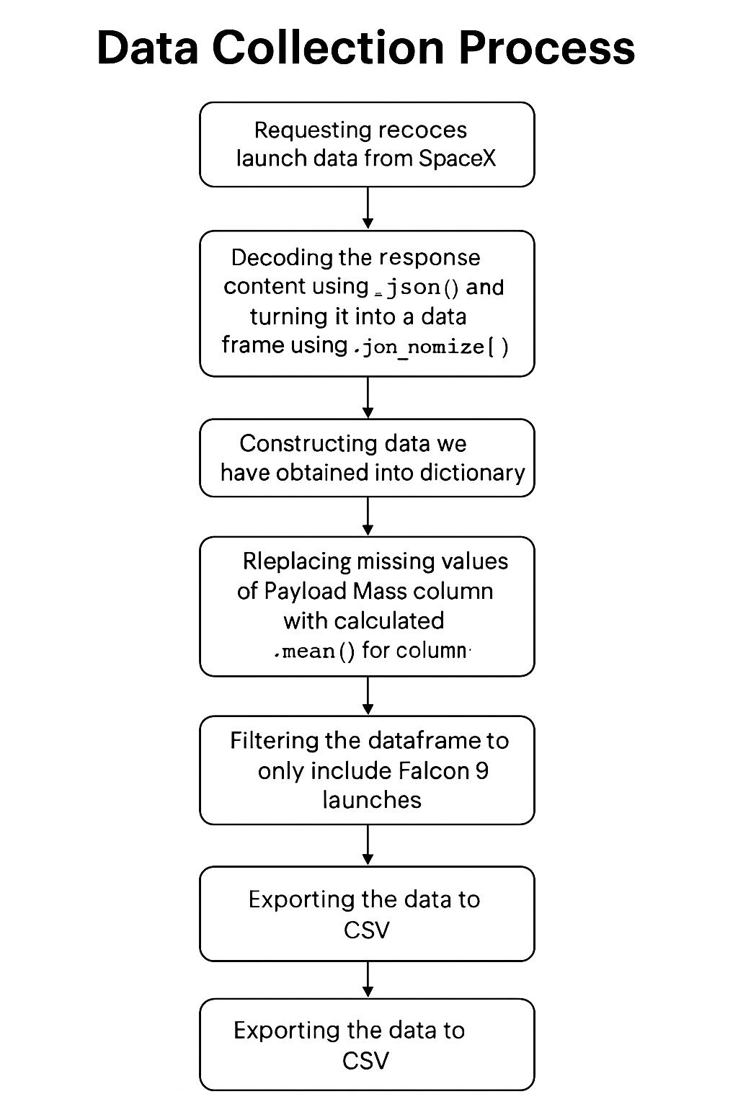
Data Collection – SpaceX API
GitHub Link: Data Collection - SpaceX API

Slide 9
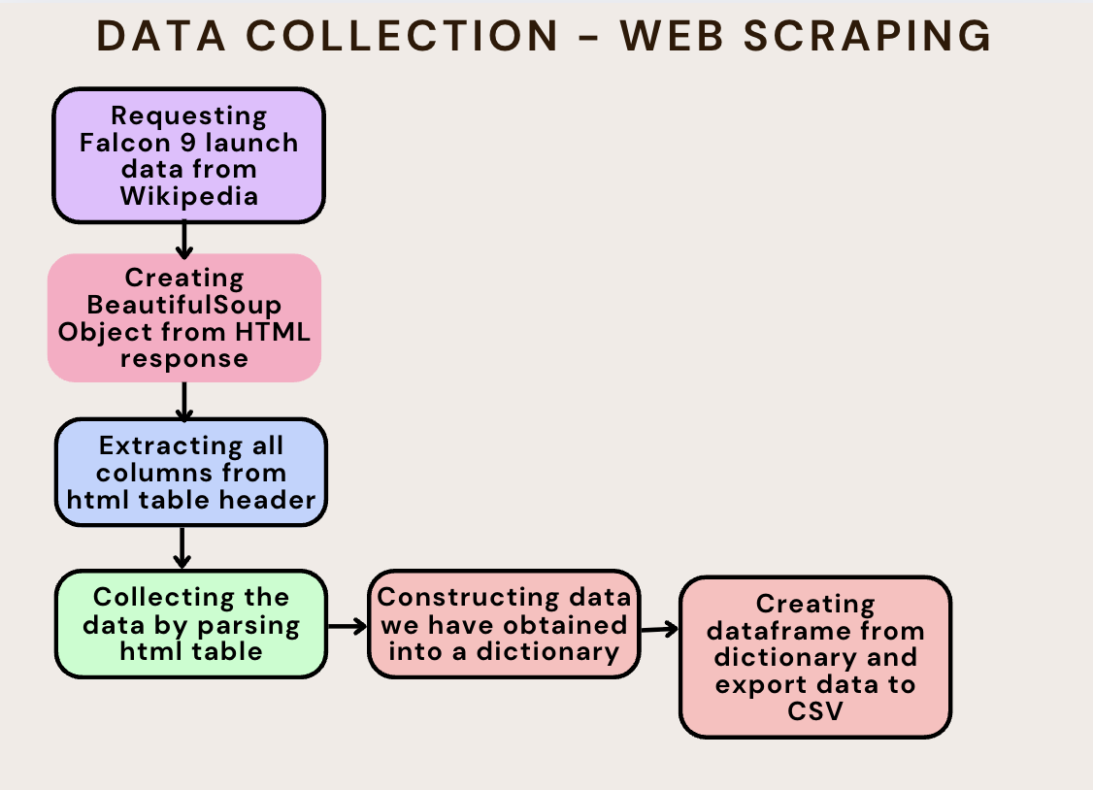
Data Collection - Scraping
GitHub Link: Data collection - Scraping

Slide 10
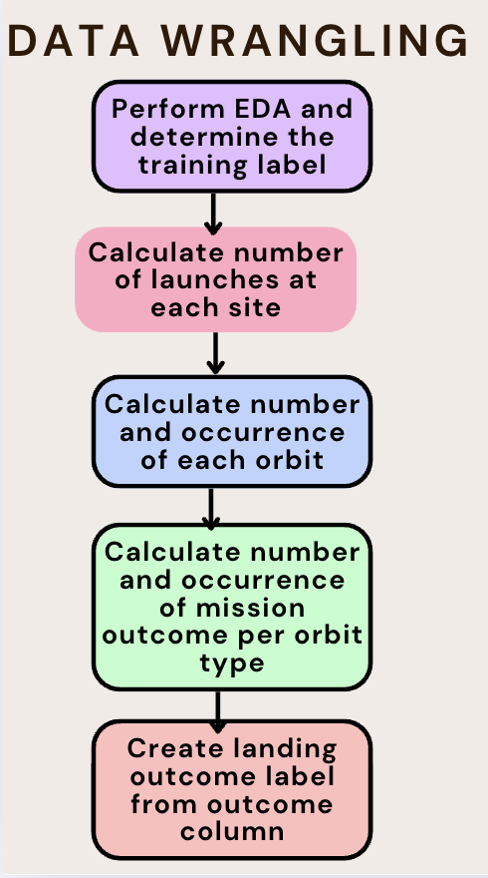
Data Wrangling
GitHub Link: Data Wrangling
The dataset includes multiple scenarios where the Falcon 9 booster did not land successfully. In some cases, a landing attempt was made but failed due to issues such as accidents. For example:
True Ocean indicates a successful landing in a designated ocean zone, whereas False Ocean refers to an unsuccessful ocean landing attempt. True RTLS (Return To Launch Site) means the booster successfully landed back on the ground pad,while False RTLS indicates a failed landing attempt at the same site. True ASDS (Autonomous Spaceport Drone Ship) refers to a successful landing on a drone ship,while False ASDS signifies an unsuccessful landing attempt on a drone ship.
To simplify analysis, these various outcomes were converted into binary training labels: "1" indicates a successful booster landing, and "0" represents a failure.

Slide 11
EDA with Data Visualization
GitHub Link: EDA with Data Visualization
A variety of charts were plotted to explore relationships in the data, including:
Flight Number vs. Payload Mass
Flight Number vs. Launch Site
Payload Mass vs. Launch Site
Orbit Type vs. Success Rate
Flight Number vs. Orbit Type
Payload Mass vs. Orbit Type
Yearly Trend of Success Rate
Chart Interpretations
Scatter Plots Used to reveal potential relationships between numerical variables. If a clear trend is observed, these variables may be useful features in a machine learning model.
Bar Charts Help compare discrete categories. They highlight how different categorical features (like orbit type or launch site) relate to outcomes such as success rates.
Line Charts Visualize trends over time, particularly helpful for analyzing progress or performance year by year (e.g., success rate over time).

Slide 12
EDA with SQL
GitHub Link: EDA with SQL
Retrieved the names of all unique launch sites used in missions.
Displayed 5 records where launch site names start with ‘CCA’.
Calculated the total payload mass delivered by boosters under NASA’s CRS missions.
Computed the average payload mass carried by the F9 v1.1 booster version.
Identified the date of the first successful landing on a ground pad.
Listed boosters that successfully landed on a drone ship and carried payloads between 4000 and 6000 kg.
Counted the number of successful and failed mission outcomes.
Retrieved booster versions that have carried the maximum payload mass.
Extracted data on failed drone ship landings in 2015, along with booster versions and launch site names.
Ranked landing outcomes (e.g., Failure – drone ship, Success – ground pad) between 2010-06-04 and 2017-03-20 in descending order of count.

Slide 13
Build an Interactive Map with Folium
Github Link: Interactive Map with Folium
Launch Site Markers:
Placed a circular marker on the map for the NASA Johnson Space Center, using its latitude and longitude as the initial reference point.
Added similar markers (with circles, popup labels, and text labels) for all other launch sites, using their coordinates to illustrate geographical locations and their distance from the equator and nearby coastlines.
Colored Markers Based on Launch Outcomes:
Used color-coded markers—green for successful launches and red for failed ones—grouped with Marker Clusters to help visualize the success rate at each launch site.
Distance Visualization to Nearby Infrastructure:
Drew colored lines from the launch site (e.g., KSC LC-39A) to nearby points of interest, such as railways, highways, coastlines, and the nearest city, to show relative distances and surroundings.

Slide 14
Build a Dashboard with Plotly Dash
GitHub Link: Plotly Dash Dashboard
Launch Site Selection Dropdown: Implemented a dropdown menu that allows users to choose a specific launch site or view data for all sites collectively.
Pie Chart Displaying Launch Successes (All Sites / Selected Site):
Integrated a pie chart to visualize the count of successful launches across all sites.
When a specific site is selected, the chart updates to compare successful vs. failed launches at that site.
Payload Mass Range Slider: Added an interactive slider to let users filter data based on payload mass range (in kilograms).
Scatter Plot of Payload vs. Success Rate by Booster Version: Created a scatter chart to show how payload mass relates to launch outcomes, categorized by different booster versions.

Slide 15
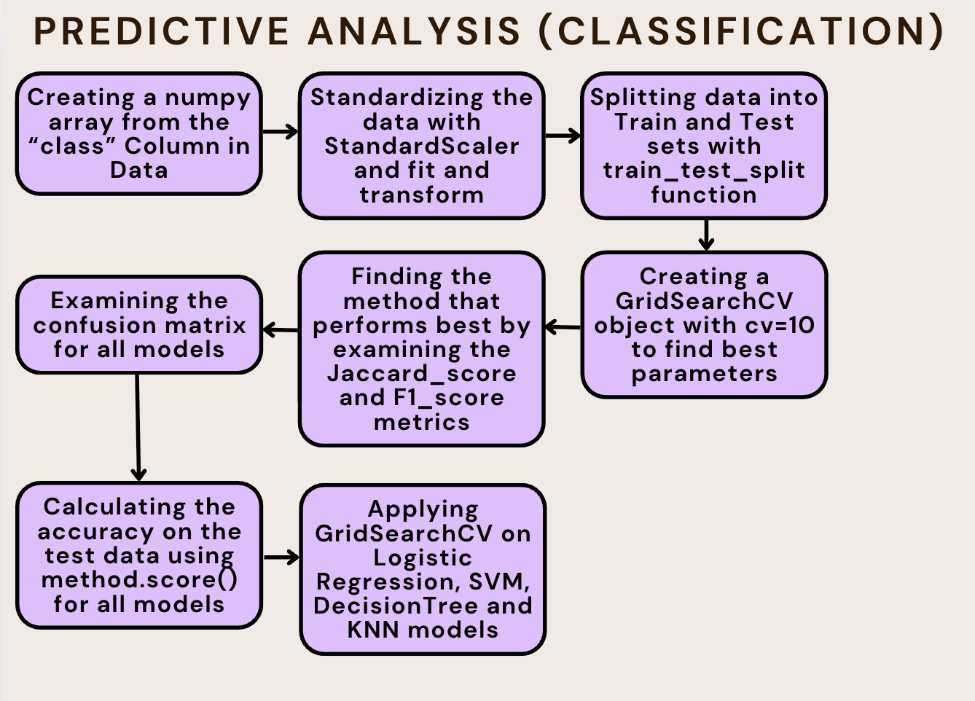
Predictive Analysis (Classification)
GitHub Link: Machine Learning Prediction

Slide 16
Results
Exploratory data analysis results
Interactive analytics demo in screenshots
Predictive analysis results

Slide 17

Section 2

Slide 18
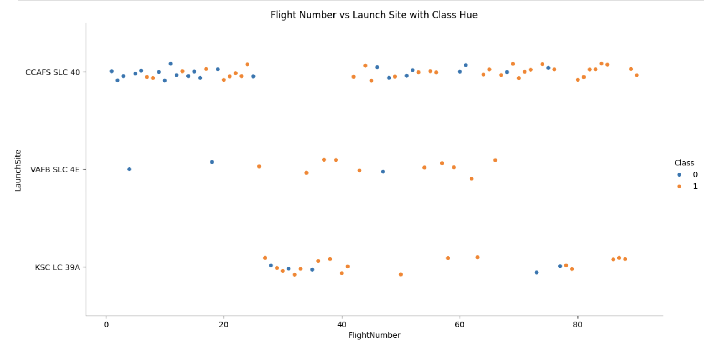
Flight Number vs. Launch Site
Explanation:
• The earliest flights all failed while the latest flights all succeeded.
• The CCAFS SLC 40 launch site has about a half of all launches.
• VAFB SLC 4E and KSC LC 39A have higher success rates.
• It can be assumed that each new launch has a higher rate of success

Slide 19
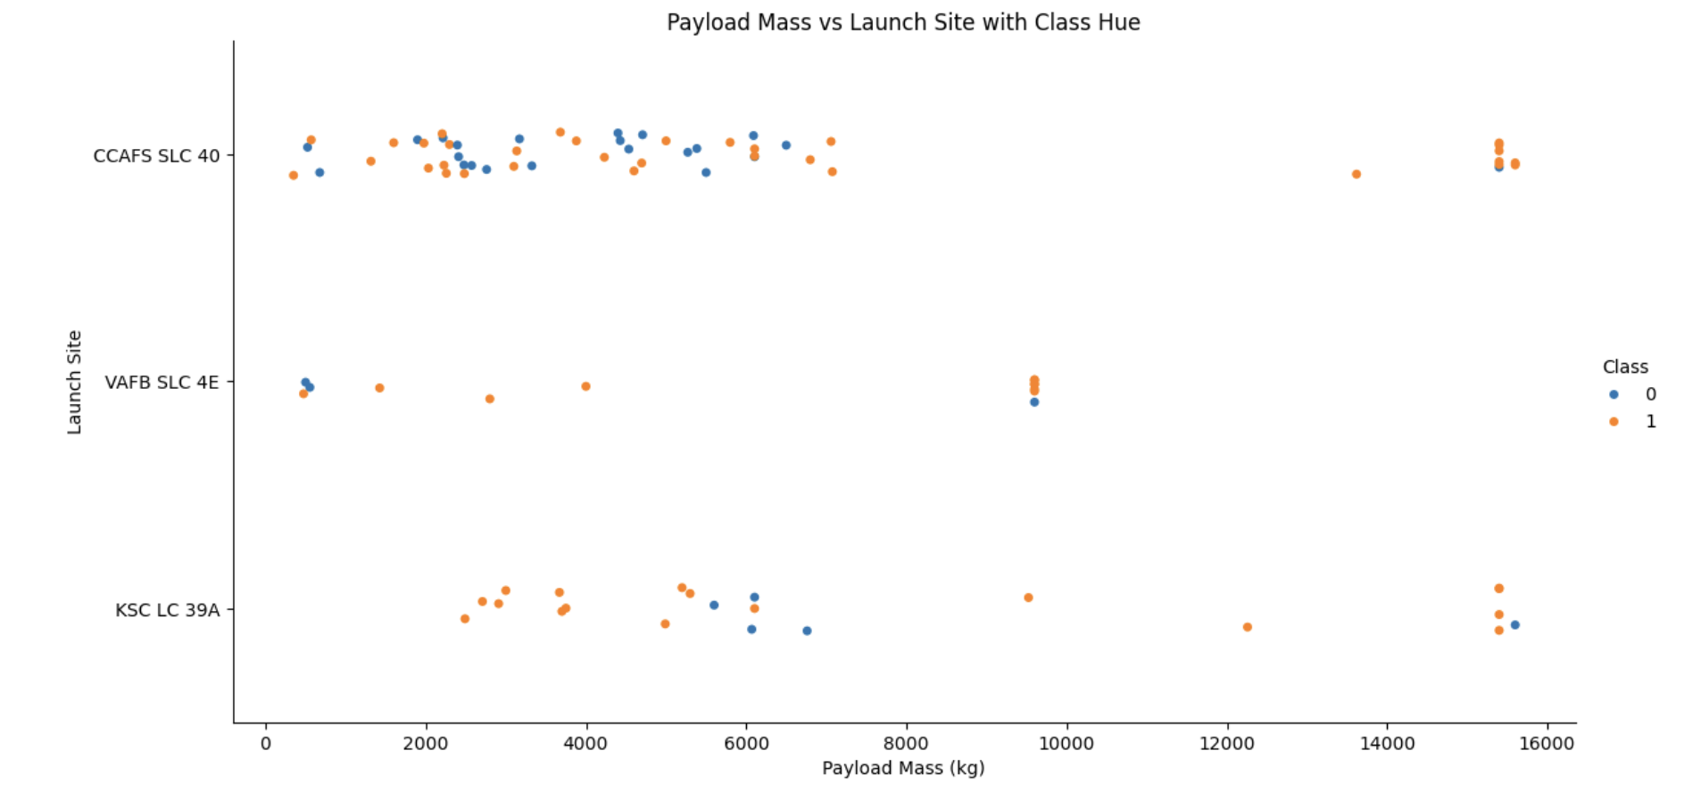
Payload vs. Launch Site
Explanation:
For every launch site the higher the payload mass, the higher the success
Most of the launches with payload mass over 7000 kg were successful.
KSC LC 39A has a 100% success rate for payload mass under 5500 kg too.

Slide 20
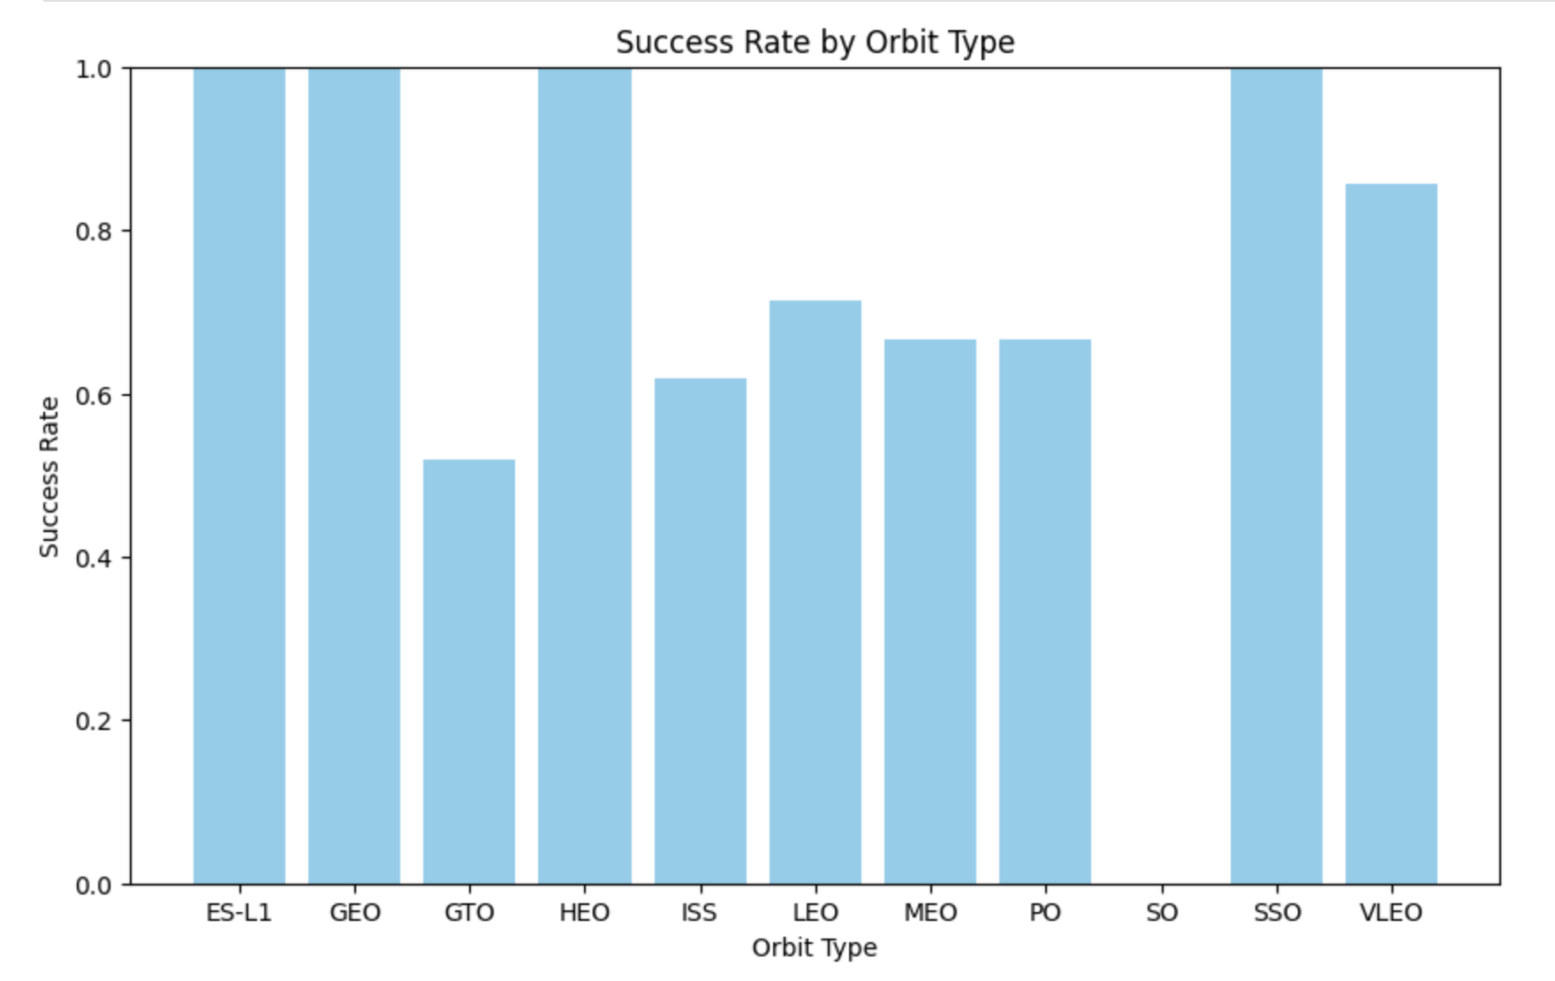
Success Rate vs. Orbit Type
Explanation:
• Orbits with 100% success rate:
- ES-L1, GEO, HEO, SSO
• Orbits with 0% success rate:
- SO
• Orbits with success rate
between 50% and 85%:
- GTO, ISS, LEO, MEO, PO

Slide 21
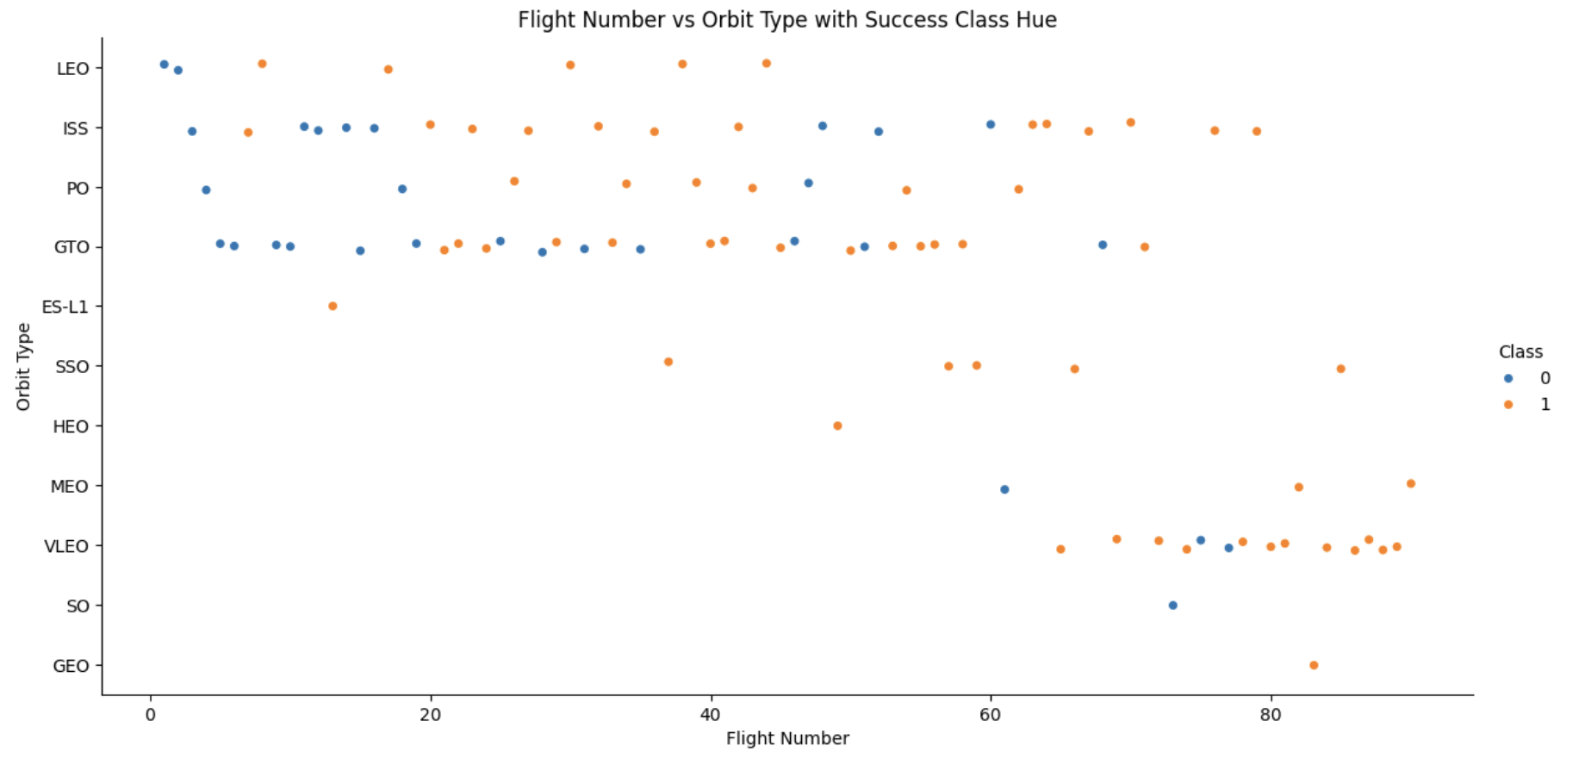
Flight Number vs. Orbit Type
Explanation:
In the LEO orbit the Success appears related to the number of flights. On the other hand, there seems to be no relationship between flight number when in GTO orbit.

Slide 22
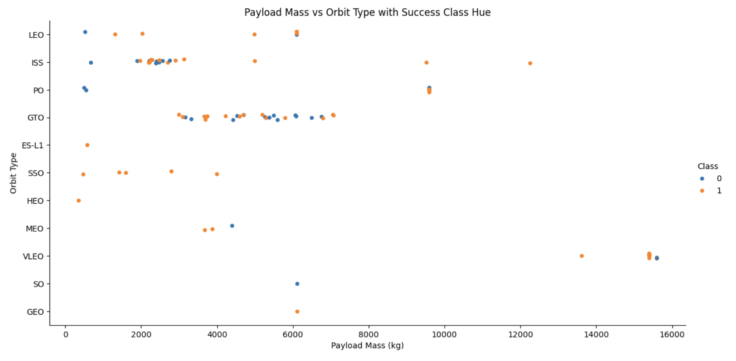
Payload vs. Orbit Type
Explanation:
Heavy payloads have a negative influence on GTO orbits and positive on GTO and Polar LEO (ISS) orbits.

Slide 23
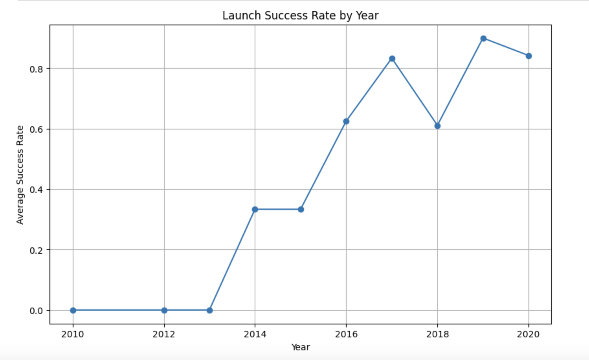
Launch Success Yearly Trend
Explanation:
The success rate since 2013 kept increasing till 2020.

Slide 24
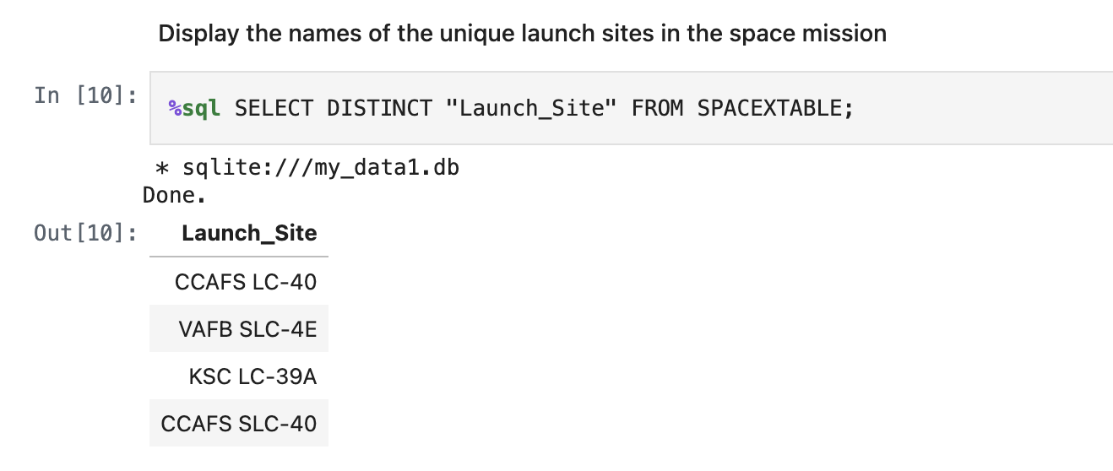
All Launch Site Names
Explanation:
Displaying the names of the unique launch sites in the space mission.

Slide 25
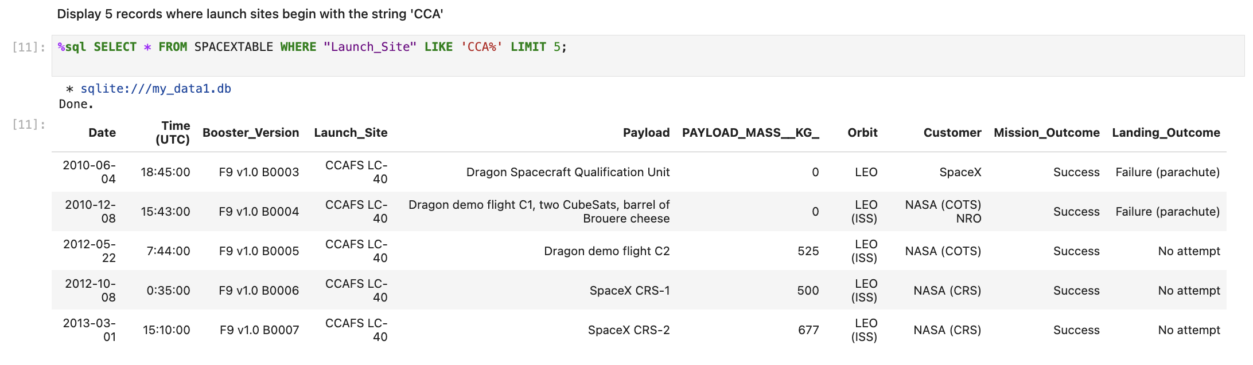
Launch Site Names Begin with 'CCA'
Explanation:
Displaying 5 records where launch site names begin with the string 'CCA'.

Slide 26
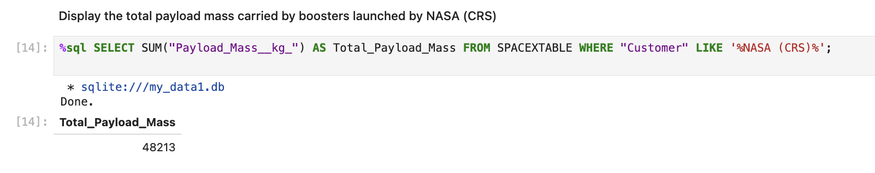
Total Payload Mass
Explanation:
Displaying the total payload mass carried by boosters launched by NASA (CRS).

Slide 27
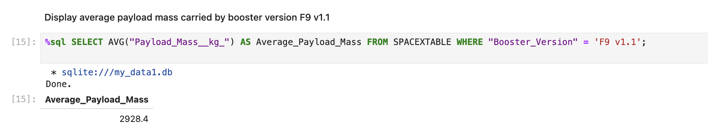
Average Payload Mass by F9 v1.1
Explanation:
Displaying average payload mass carried by booster version F9 v1.1.

Slide 28
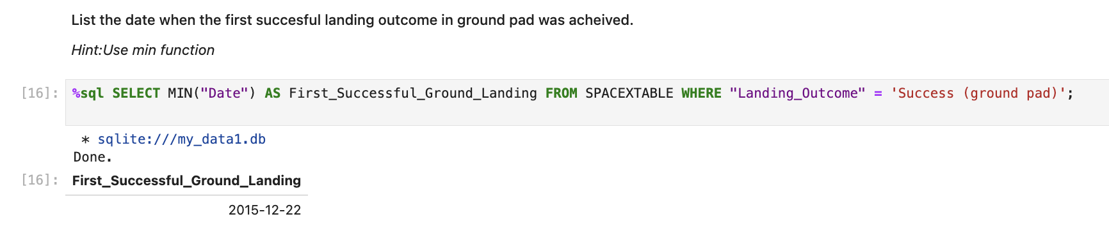
First Successful Ground Landing Date
Explanation:
Listing the date when the first successful landing outcome in ground pad was achieved which is 2015-12-22.

Slide 29
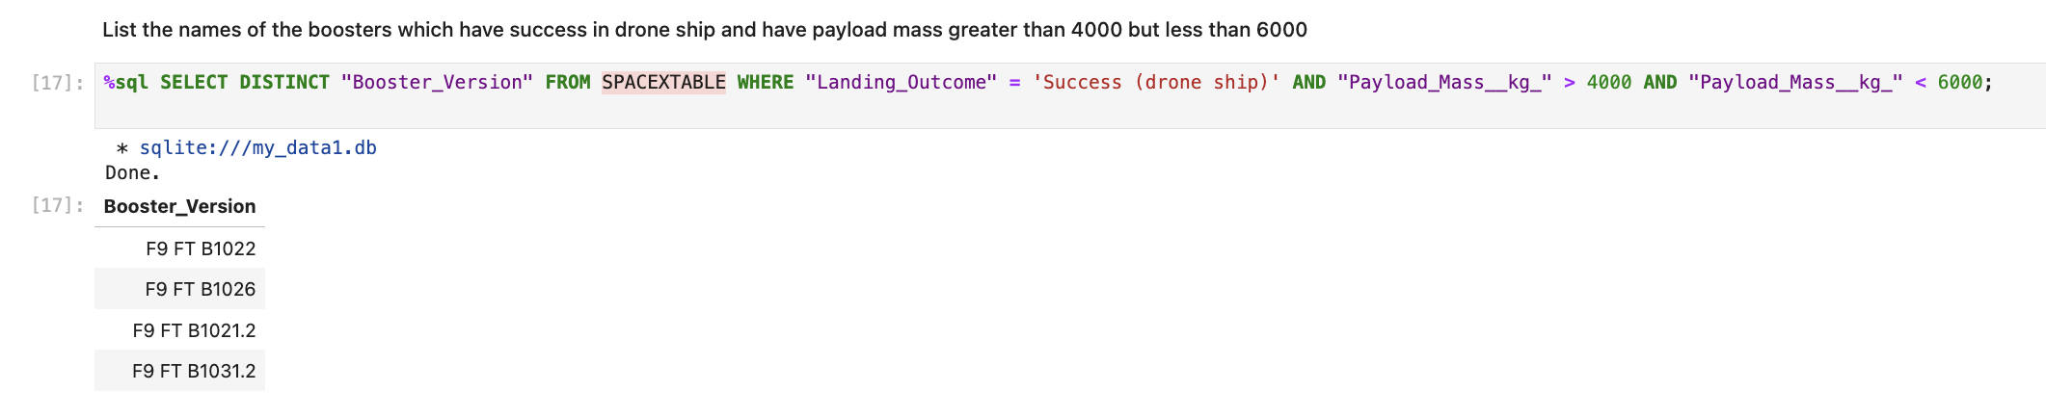
Successful Drone Ship Landing with Payload between 4000 and 6000
Explanation:
Listing the names of the boosters which have success in drone ship and have payload mass greater than 4000 but less than 6000.

Slide 30
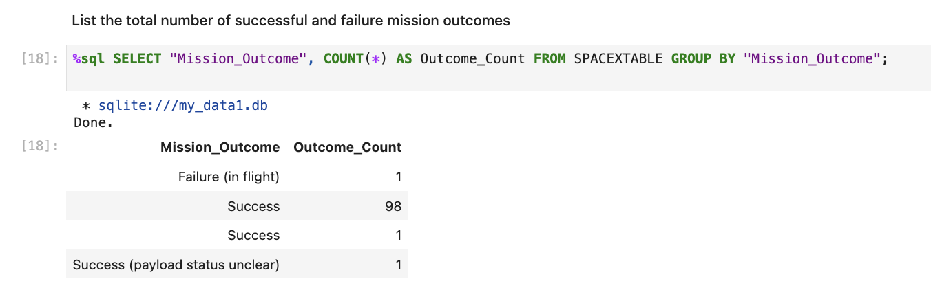
Total Number of Successful and Failure Mission Outcomes
Explanation:
Listing the total number of successful and failure mission outcomes.

Slide 31
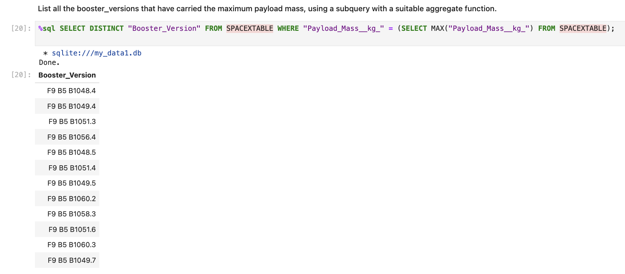
Boosters Carried Maximum Payload
Explanation: Listing all the booster_versions that have carried the maximum payload mass, using a subquery with a suitable aggregate function.

Slide 32
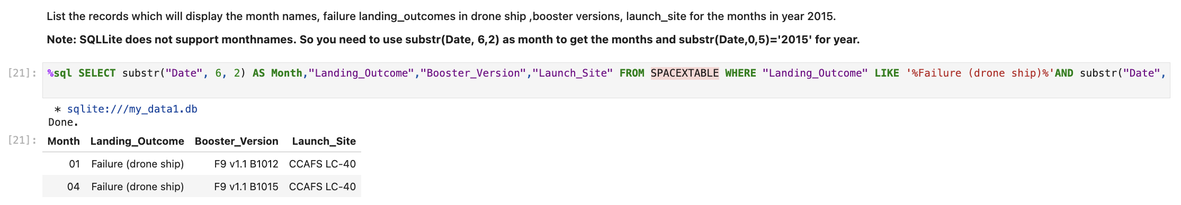
2015 Launch Records
Explanation: Listing the records which will display the month names, failure landing_outcomes in drone ship ,booster versions, launch_site for the months in year 2015.

Slide 33
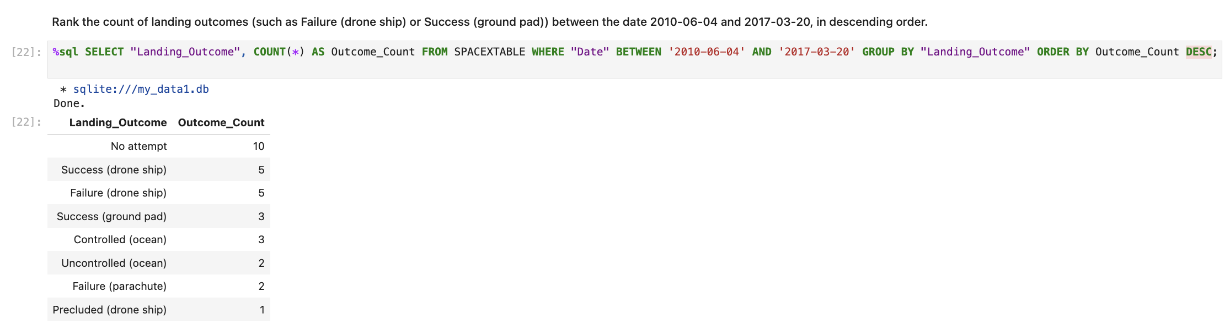
Rank Landing Outcomes Between 2010-06-04 and 2017-03-20
Explanation: Ranking the count of landing outcomes (such as Failure (drone ship) or Success (ground pad)) between the date 2010-06-04 and 2017-03-20, in descending order.

Slide 34

Section 3

Slide 35
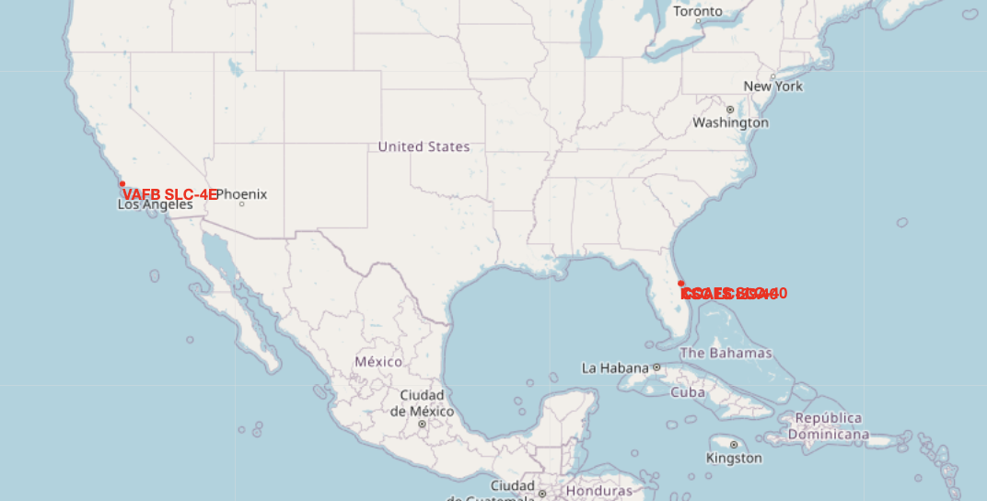
All Launch sites location markers on a global map
Explanation: Most launch sites are located near the equator. This is because the Earth's surface rotates fastest at the equator—about 1670 km/h. Launching from this region allows spacecraft to take advantage of this rotational speed due to inertia, helping them achieve the necessary velocity to enter and stay in orbit more efficiently.
Additionally, all launch sites are situated close to coastlines. Launching rockets over the ocean reduces the risk to human populations by ensuring that any debris or potential explosions occur away from inhabited areas.

Slide 36
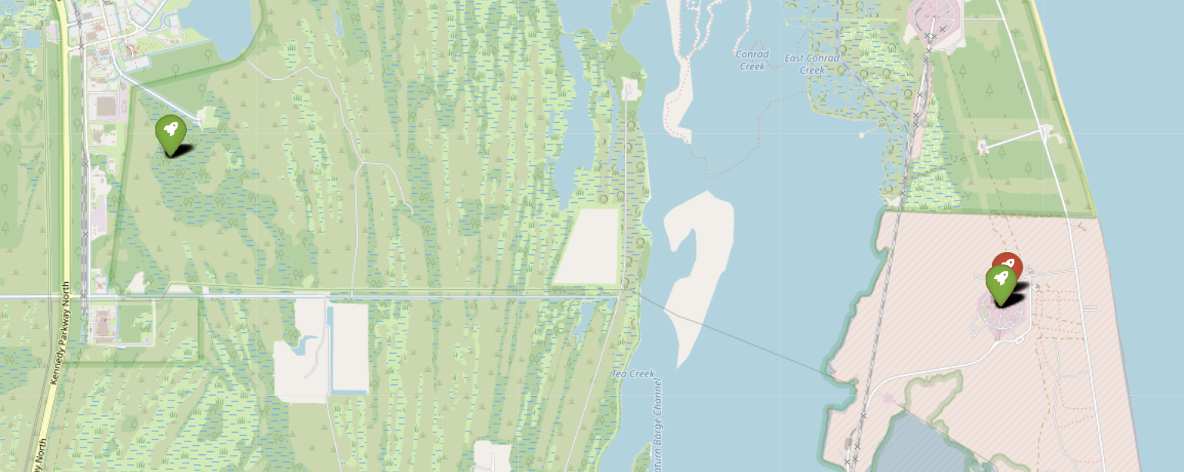
Colour-labeled launch records on the map
Explanation:
From the colour-labeled markers we should be able to easily identify which launch sites have relatively high success rates.
Green Marker = Successful Launch
Red Marker = Failed Launch
Launch Site KSC LC-39A has a very high Success Rate.

Slide 37
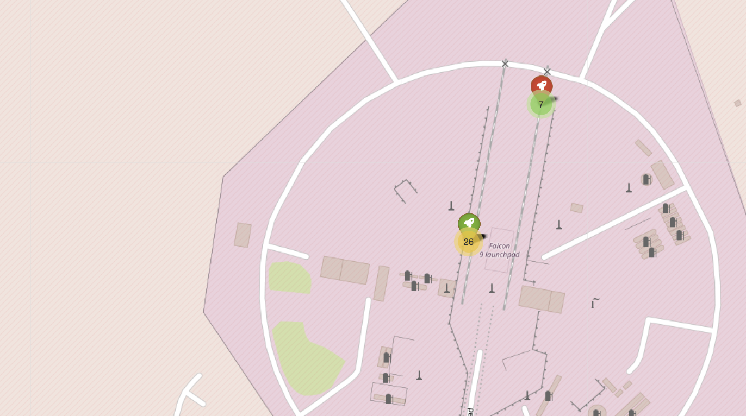
Distance from the launch site KSC LC-39A to its proximities
Explanation: From the visual analysis of the launch site KSC LC-39A we can clearly see that it is: - relative close to railway (15.23 km) - relative close to highway (20.28 km) - relative close to coastline (14.99 km)
Also the launch site KSC LC-39A is relative close to its closest city Titusville (16.32 km).Failed rocket with its high speed can cover distances like 15-20 km in few seconds. It could be potentially dangerous to populated areas.

Slide 38

Section 4

Slide 39
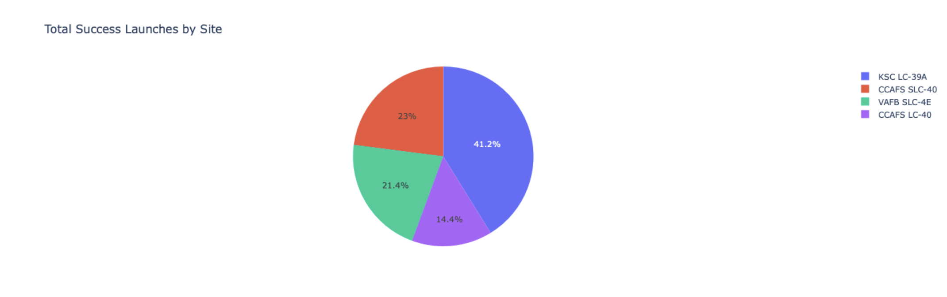
Total Success Launches by Site – Pie Chart
Explanation:
The chart clearly shows that from all the sites, KSC LC-39A has the most successful launches.

Slide 40
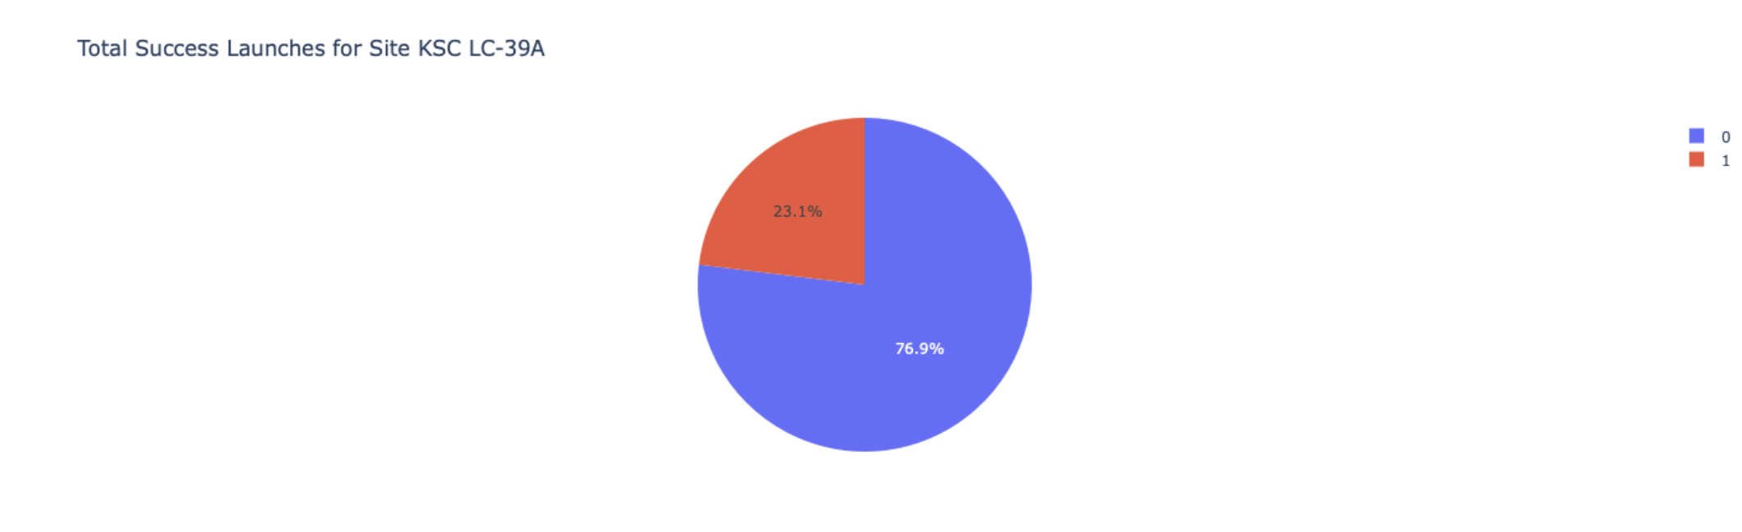
Launch site with highest launch success ratio
Explanation:
KSC LC-39A has the highest launch success rate (76.9%) with 10 successful and only 3 failed landings.

Slide 41
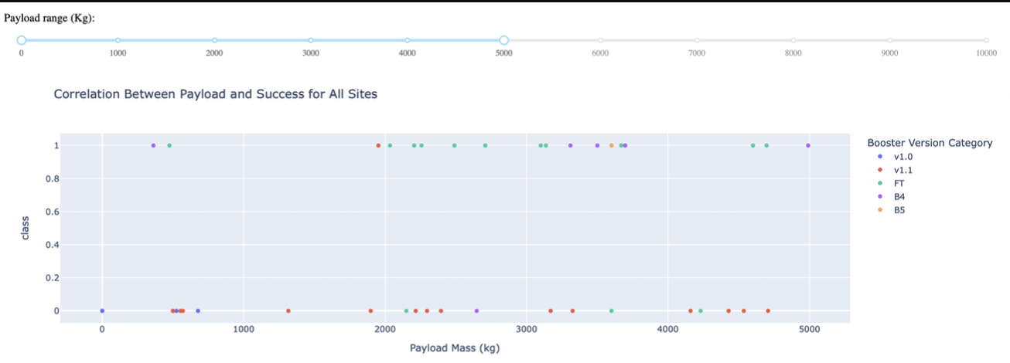
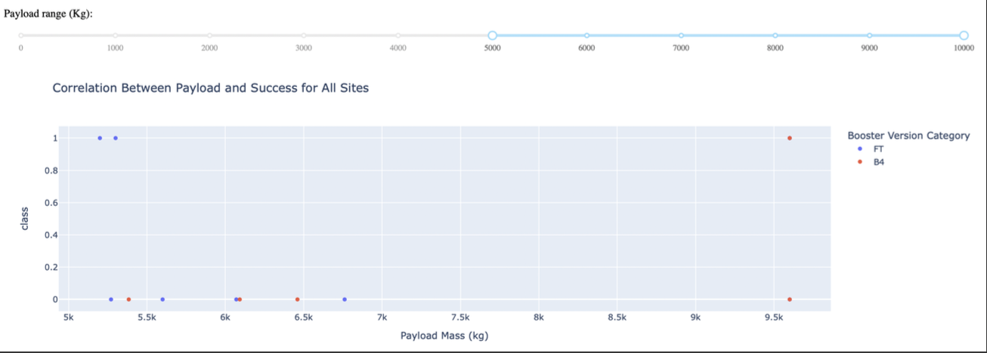
Payload Mass vs. Launch Outcome for all sites
Explanation:
The charts show that payloads between 2000 and 5500 kg have the highest success rate.

Slide 42

Section 5

Slide 43
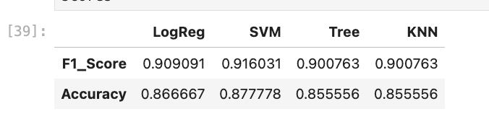
Classification Accuracy
Explanation: The scores of the whole Dataset confirm that the best model is the Decision Tree Model. This model has not only higher scores, but also the highest accuracy.

Slide 44
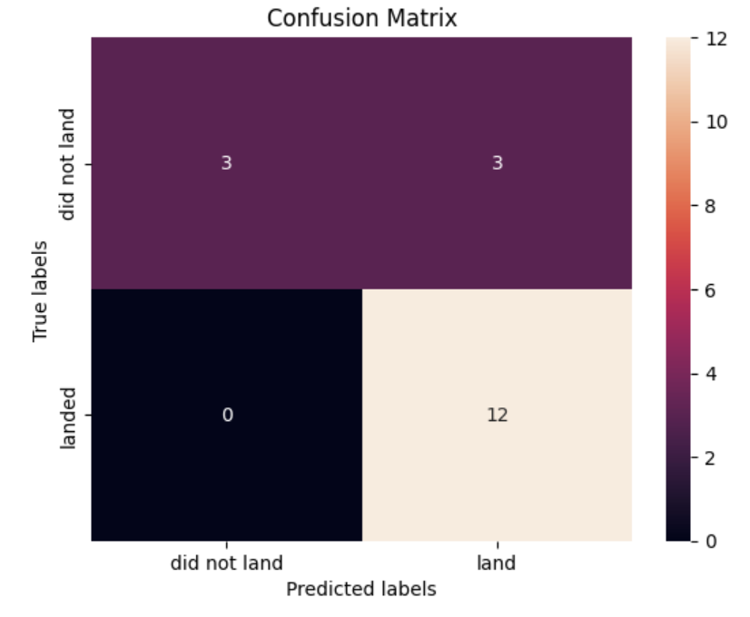
Confusion Matrix
Explanation:
Examining the confusion matrix, we see that logistic regression can distinguish between the different classes. We see that the major problem is false positives.

Slide 45
Conclusions
• Decision Tree Model is the best algorithm for this dataset.
• Launches with a low payload mass show better results than launches with a larger payload mass.
• Most of launch sites are in proximity to the Equator line and all the sites are in very close proximity to the coast.
• The success rate of launches increases over the years.
• KSC LC-39A has the highest success rate of the launches from all the sites.
• Orbits ES-L1, GEO, HEO and SSO have 100% success rate.

Slide 46
Appendix
Thanks to Coursera, IBM for this course!

Slide 47


